Slide 1

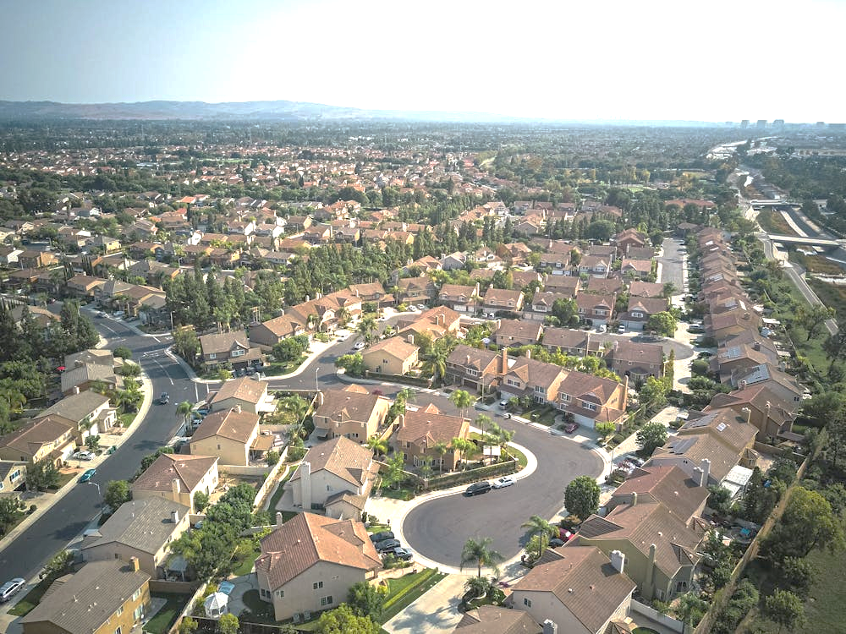


AI Real Estate Estimate
Safwan Ali, Alexander Krivitsky, Brian Huang, Keena Vasiloff, Jason Gill, and Nivrithi Krishnan
Notes:
1st option

Slide 2
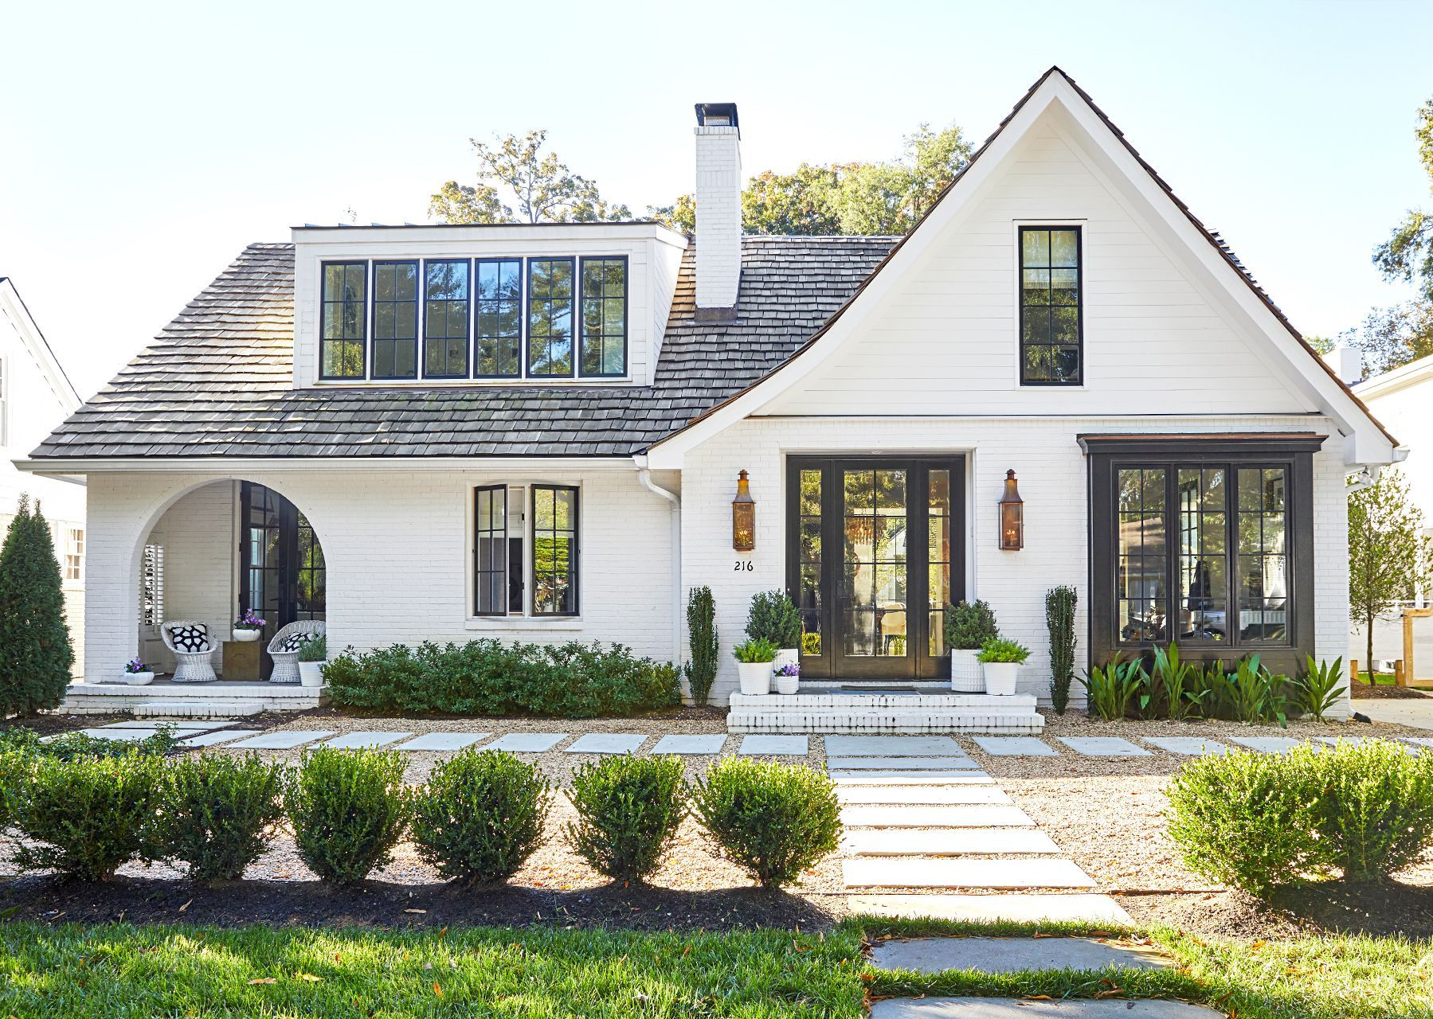

TABLE OF CONTENTS
01
Introduction
04
Results
02
Background
05
Discussion
03
Methodology
06
Conclusion

Slide 3

INTRODUCTION

Slide 4
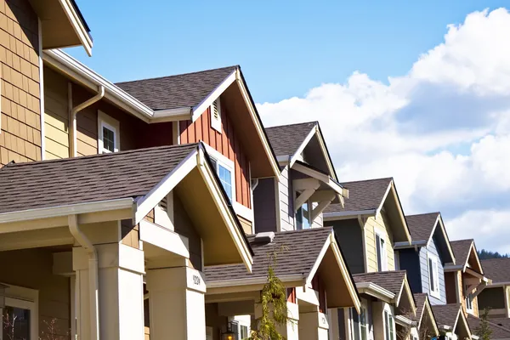



Introduction
OBJECTIVES
Utilize multiple supervised learning algorithms to accurately estimate property values based on important features
Conduct a comparative analysis to understand the strengths and weaknesses of multiple models
Enhance transparency by thoroughly documenting the behavior of our models and decision making project

Slide 5

BACKGROUND

Slide 6
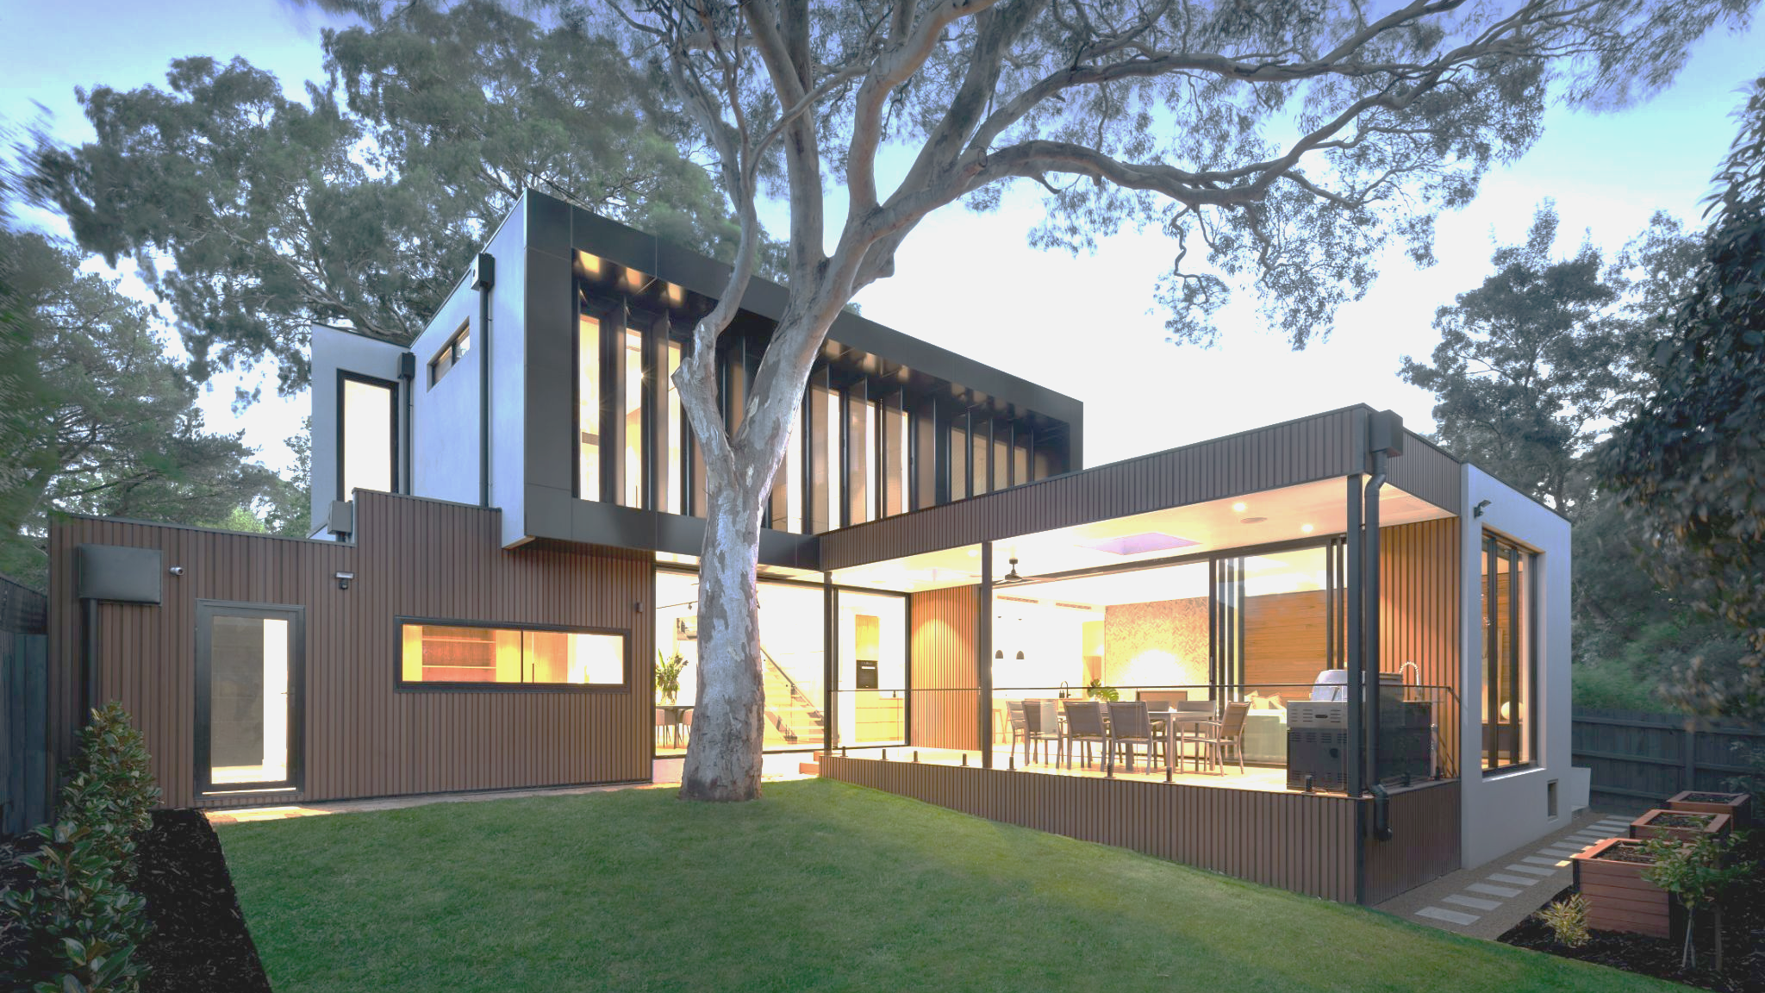



Background
REAL ESTATE
Purpose: To provide accurate property valuations
Problem: Manual assessments by appraisers are subjective & due to significant variation between evaluators leading to inconsistency
Solution: A data-driven, reliable, objective, and consistent valuation method

Slide 7

Background
UNDERSTANDING
Key ML concepts
Supervised learning involves training a model on a labeled dataset to make accurate predictions on new, unseen data
Regression analysis plays an important role in identifying and modeling the relationships between features and property prices. The 3 models we will be focusing on are
Linear Regression
Decision Trees
Random Forests
Existing AI Tools: Zillow’s Zestimate

Slide 8

METHODOLOGY

Slide 9

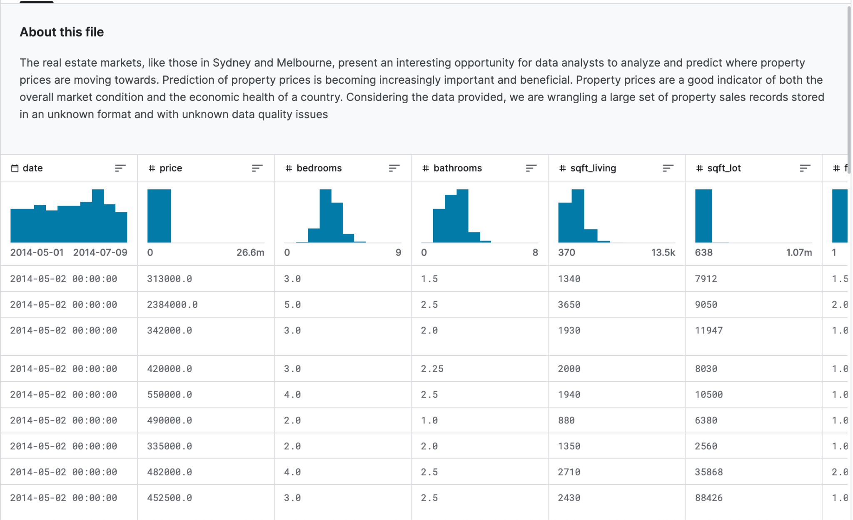
Methodology
DATASET SOURCE
Source: "USA Housing Dataset" (Kaggle)
Location: Washington, USA
Year: 2014
Included features: date, price, bedrooms, bathrooms, sqft_living, sqft_lot, floors, waterfront, view, condition, sqft_above, sqft_basement, yr_built, yr_renovated, street, city, state zip, and country

Slide 10
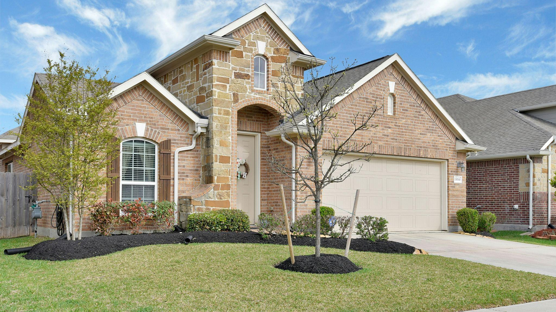
Methodology
DATASET PROCESSING
Data Cleaning:
Handle missing values
Remove rows with incomplete data
Identify and handle outliers
Feature Engineering:
One-hot encoding for categorical features
Normalization using StandardScaler for continuous features
Data Splitting:
Train-test split (80:20 ratio)

Slide 11
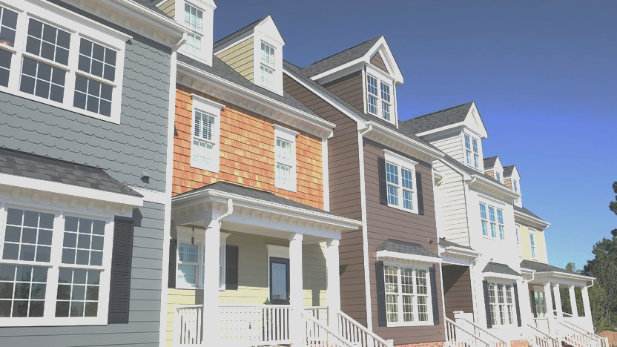
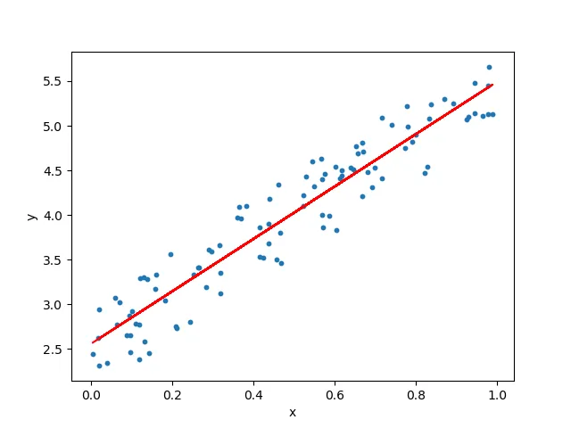
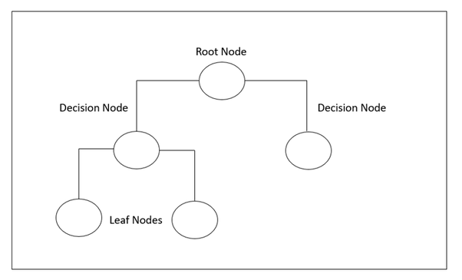
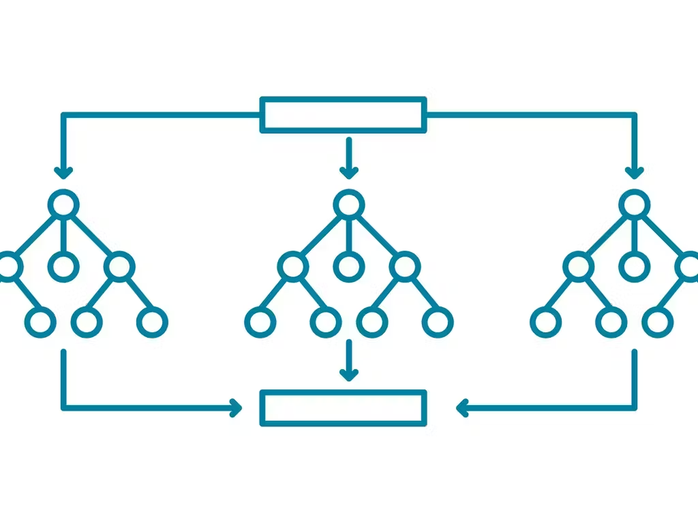
Methodology
BUILDING OUR MODELS
Linear Regression
Decision Tree
Random Forest

Slide 12
Methodology
OPTIMIZATION & DATA TRANSFORMATION
Hyperparameter Tuning
Framework: Optuna
Key hyperparameters tuned
Decision Tree: Maximum depth, minimum samples split, and minimum samples leaf
Random Forest: Number of estimators, maximum depth, minimum samples split, and minimum samples leaf
Handling Skewed Data
Log Transformation: stabilizes the variance and makes the data more normally distributed
Ensures that the model's assumptions of normality and homoscedasticity are better met
Feature Scaling: ensures uniform contribution to model training
Continuous features were scaled using StandardScaler

Slide 13
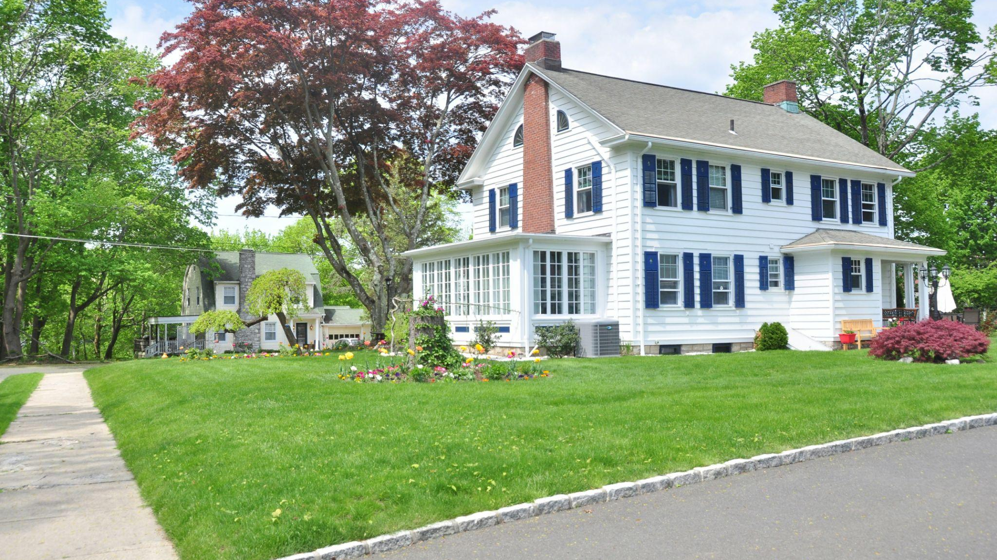
Methodology
EVALUATION METRICS
Metric | Purpose
Mean Squared Error (MSE) | measure of the prediction error (a lower MSE indicates a better fit to the data)
R-Squared (R²) | determines proportion of variance in the dependent variable that can be explained by the independent variables (a higher R² value indicates better model performance)
Comparison with Zillow Zestimate | determines how well our models perform relative to an established industry benchmark

Slide 14
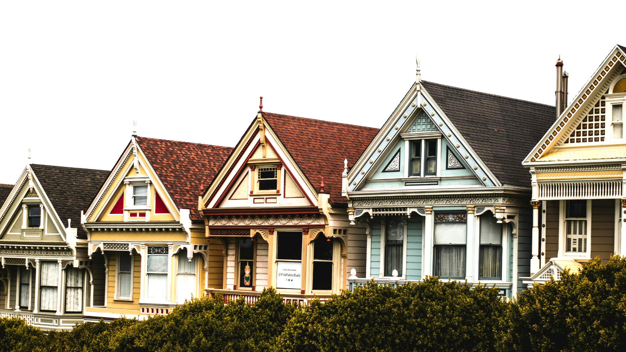
RESULTS

Slide 15
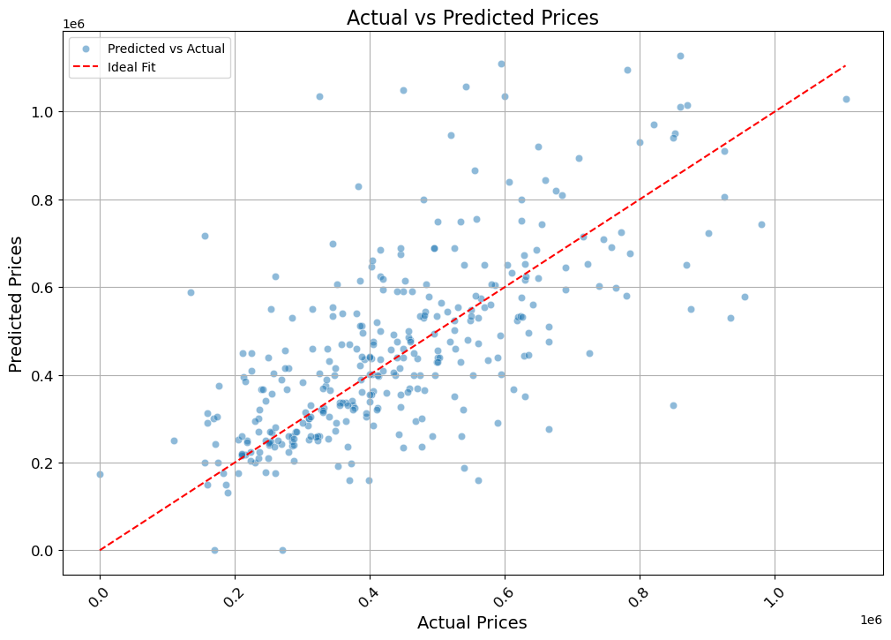
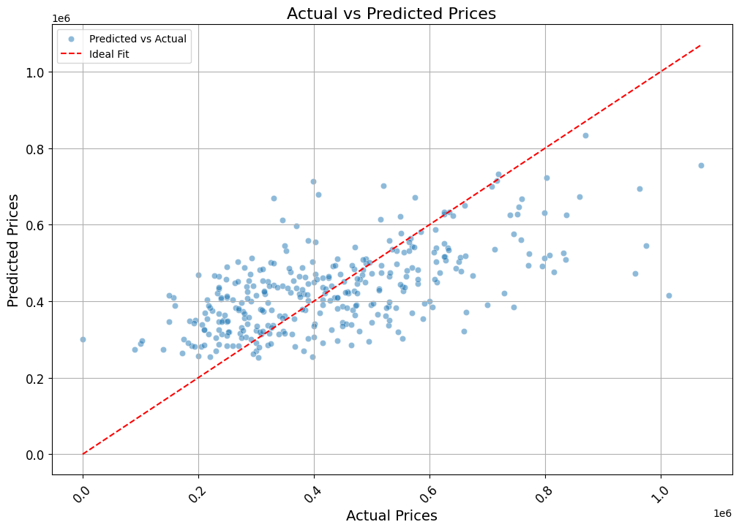
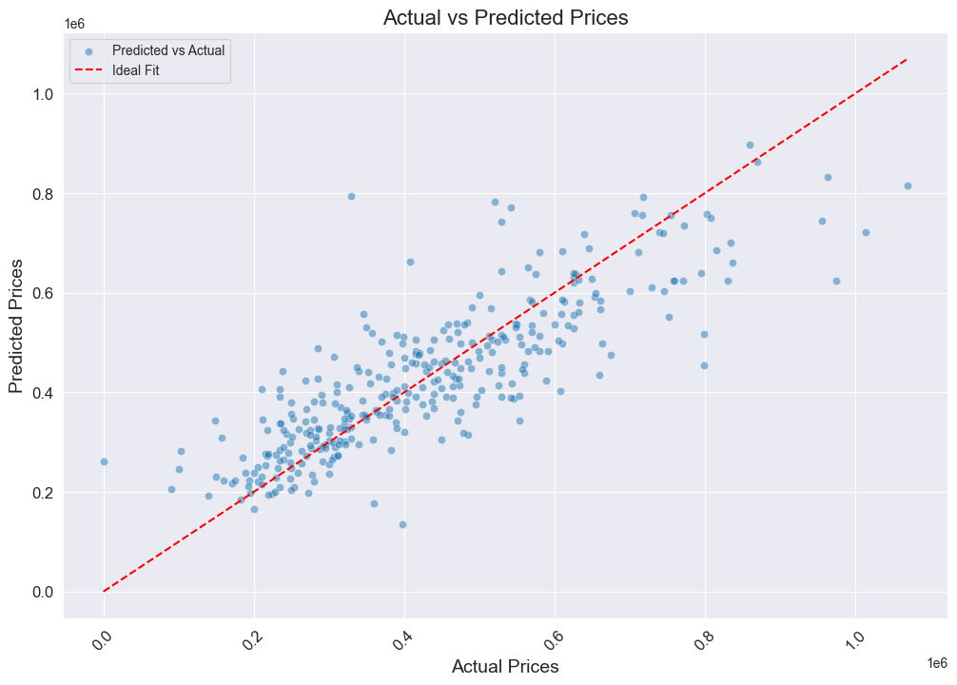
Results
EVALUATION METRICS
*Scatter plot comparing the actual house prices and those predicted by the specified model
The red dashed line represents the ideal perfect prediction
Figure 1: Linear Regression Model
Figure 2: Decision Tree Model
Figure 3: Random Forest Model

Slide 16
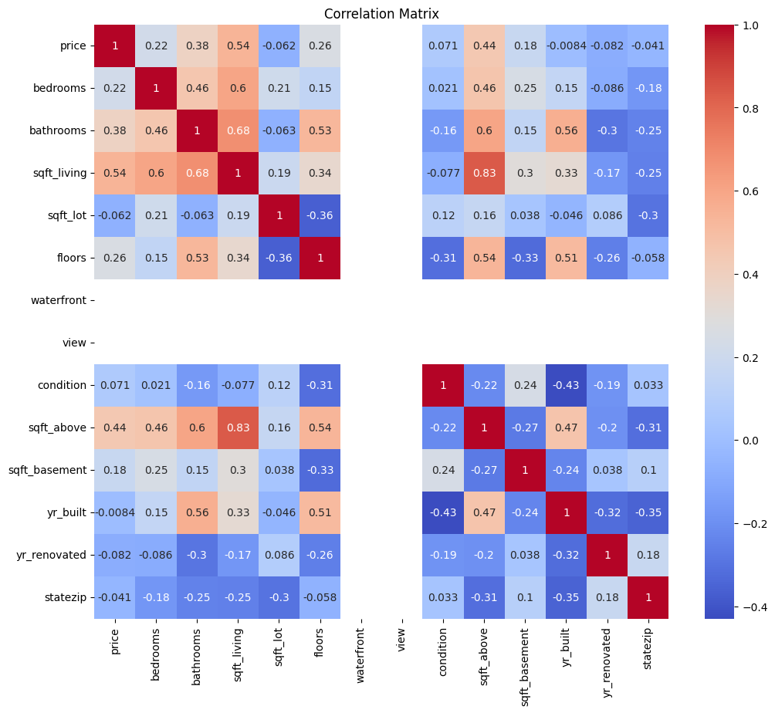
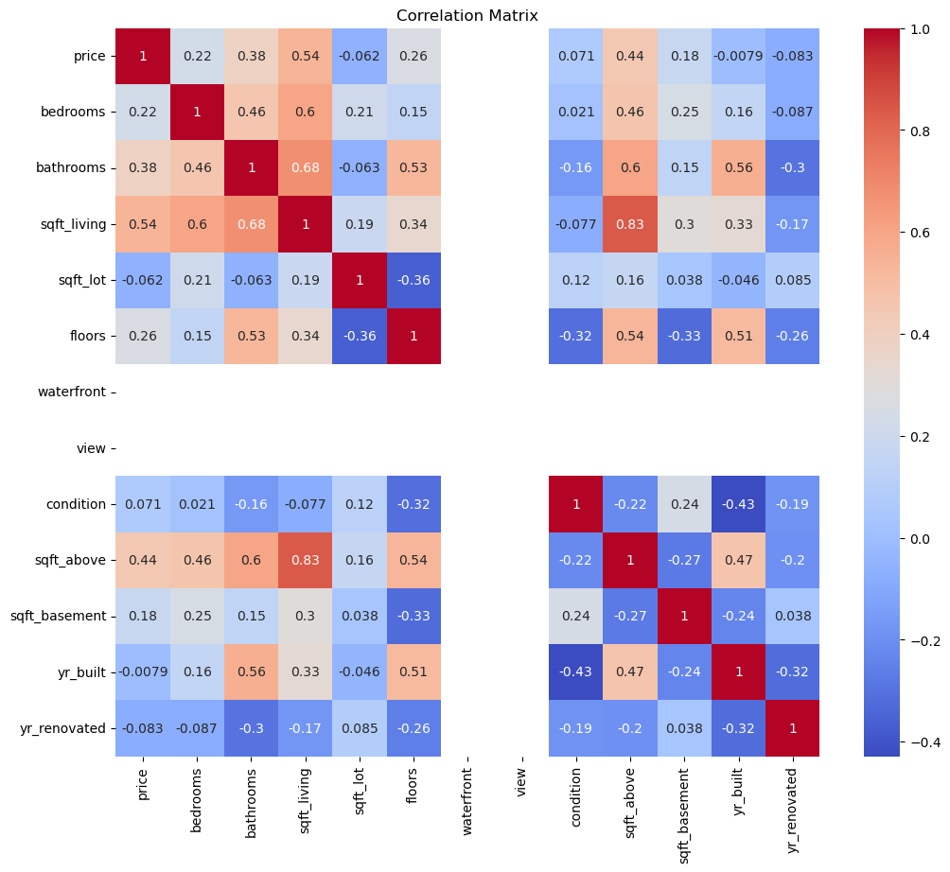
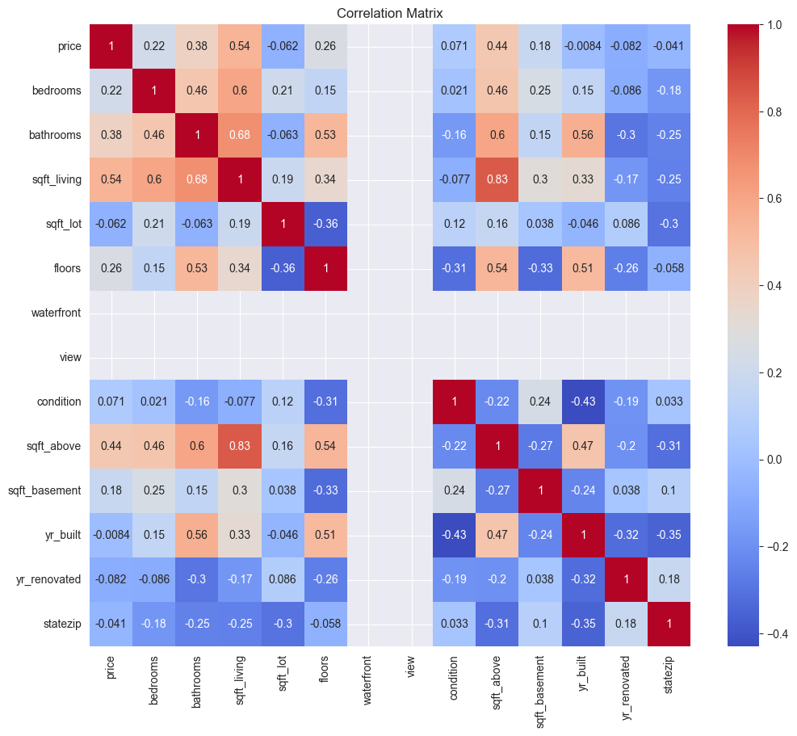
Results
FEATURE IMPORTANCE
*Heat map for specified model illustrating the correlation between various features in the dataset
Strong positive correlations are shown in red, and strong negative correlations are in blue.
Figure 4: Linear Regression Model
Figure 5: Decision Tree Model
Figure 6: Random Forest Model

Slide 17
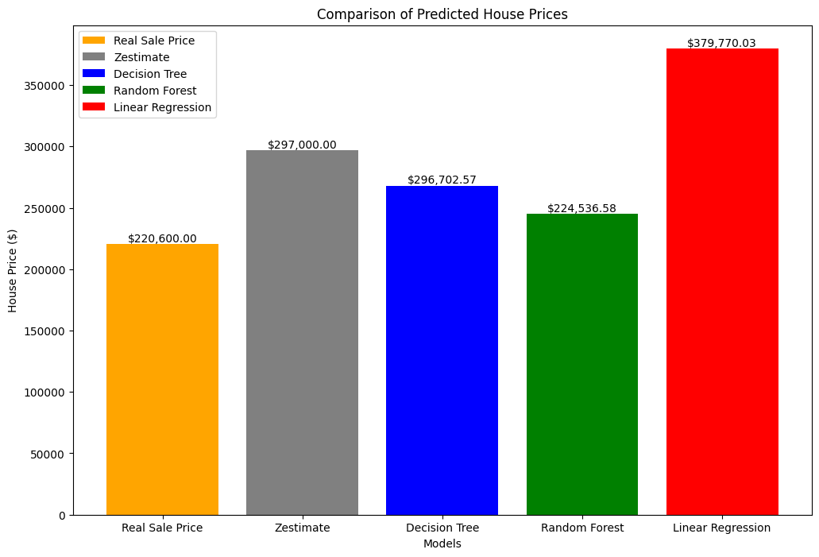
Results
COMPARATIVE ANALYSIS
Figure 7: Bar plot comparing prices predicted by each model to the dataset sale price

Slide 18
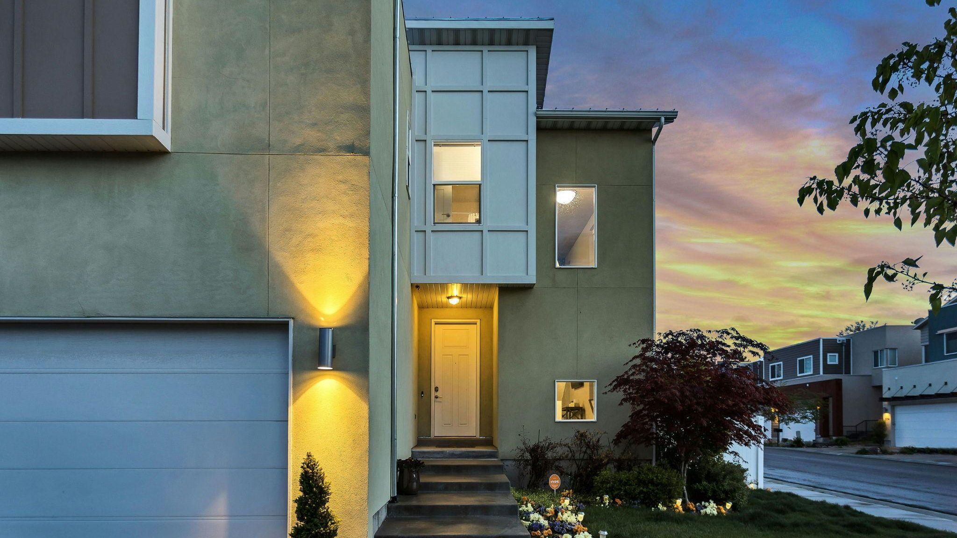
DISCUSSION

Slide 19
Discussion
MODEL PERFORMANCE
Linear regression: provided a baseline, but the model’s low accuracy and high error underscore the limitations of linear models
Decision tree regressor: performed significantly better, highlighting the importance of capturing non-linear relationships
Random forest: serves as the most reliable tool for real estate valuation, demonstrates the effectiveness of ensemble methods

Slide 20
Discussion
ZILLOW ZESTIMATE
& OTHER ETHICAL CONSIDERATIONS
Ethical Considerations
The source of our data is specified and linked
Thorough documentation provides step-by-step explanations of all processes
Detailed feature analysis, providing their respective importance scores, and displaying the correlation matrix mapping the relationship between the different features and target, users can clearly identify which features have a higher influence over property valuations, and impact on the price
Comparison to Zillow’s Zestimate
No outside visibility into the exact methods or data points used to calculate a home’s value
Heavily reliant on user-submitted data and public records
Data collected by their platform includes sensitive information (ex: tax history)

Slide 21

Discussion
LEARNINGS & CHALLENGES
Learning: Importance of clean, high-quality data
Preprocessing Techniques: Handling missing values, outliers, and feature engineering significantly improved performance
Challenge: Low accuracy, linear models especially struggled with market complexities
Optimization Techniques: Hyperparameter tuning and log transformation addressed skewness and enhanced accuracy
Learning: Impact of Non-Linear Models
Focused on Decision Trees and Random Forests to capture complex interactions
Learning: Importance of Transparency
Emphasized ethical AI practices thorough thorough documentation to build user trust

Slide 22

CONCLUSION

Slide 23
Conclusion
SUMMARY
Objective: Leverage machine learning to accurately estimate real estate prices
Methods: Utilized supervised learning algorithms with rigorous data preprocessing and feature engineering
Models Compared:
Linear Regression: Baseline model
Decision Tree Regressor: Captured non-linear relationships
Random Forest Regressor: Most reliable, aggregated multiple trees’ predictions

Slide 24
Conclusion
FUTURE WORK & IMPACT
Future Work
Additional Features: Include neighborhood crime rates, school quality, and other diverse factors
Advanced Models: Explore Gradient Boosting Machines (GBM) and deep learning techniques
Real-Time Data: Integrate real-time market trends and economic indicators
User Interface: Develop a user-friendly tool for instant property valuations
Ethical AI: Continue focusing on data privacy, transparency, and responsible usage
Impact
Revolutionizing Real Estate: AI-driven tools can enhance efficiency, reliability, and fairness in property valuations
Practical Application: Providing valuable insights for buyers, sellers, and real estate professionals
Setting Standards: Promoting responsible and transparent AI use in the industry

Slide 25
Q&A
Notes:
1st option

Slide 26
Thank You 🥳
Notes:
1st option

